Slide 1
Fitting time series models, Part 2
CIHR Course Week 3
Isabel (Izzie) Fulcher
isabel_fulcher@hms.harvard.edu

Slide 2
Teaching Objectives
Quick recap of time series modeling from Part 1
Seasonality and time trends
Syndromic surveillance
Motivation
Steps
Group activity
Prediction intervals

Slide 3
Part 1 Recap

Slide 4
Research questions with time series data
Describe the behavior of an indicator over time
Is infant mortality decreasing over time? By how much?
What are the seasonal differences in malaria cases?
Detect deviations from expected in an indicator
Is a region experiencing higher than expected cases of diarrhea?
Is the number of health facility deliveries lower than expected?
Measure the impact of an intervention on an indicator
After social distancing measures were put in place, how many fewer COVID-19 cases were there?
Notes:
What have we done so far?

Slide 6
outcome_{t} =β₀+ε_{t}
intercept only model

Slide 7
outcome_{t} =β₀+ β₁·time+ε_{t}
intercept and slope model

Slide 8
outcome_{t} =β₀+ β₁·time+β₂·time²+ε_{t}
quadratic model

Slide 9
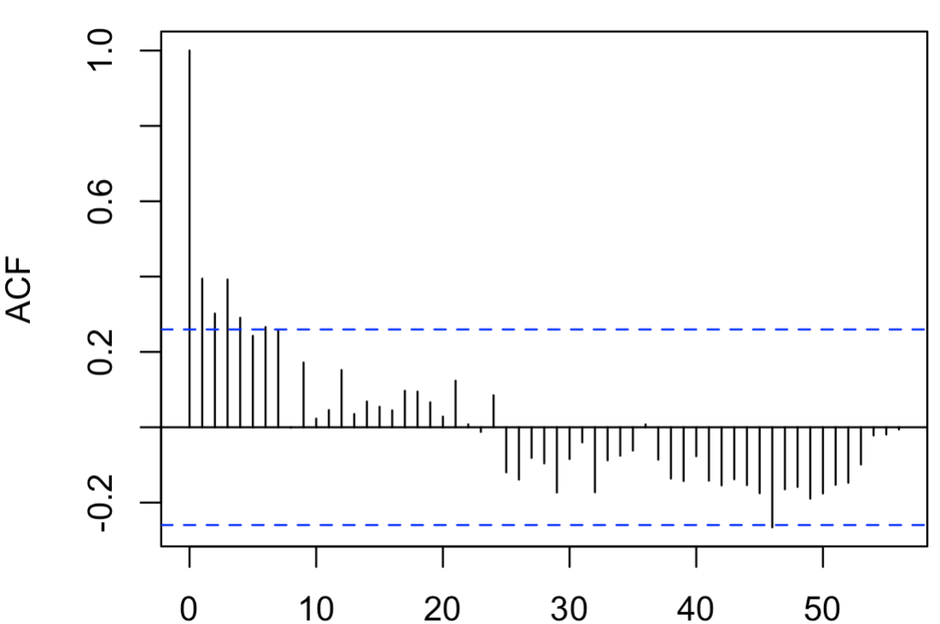
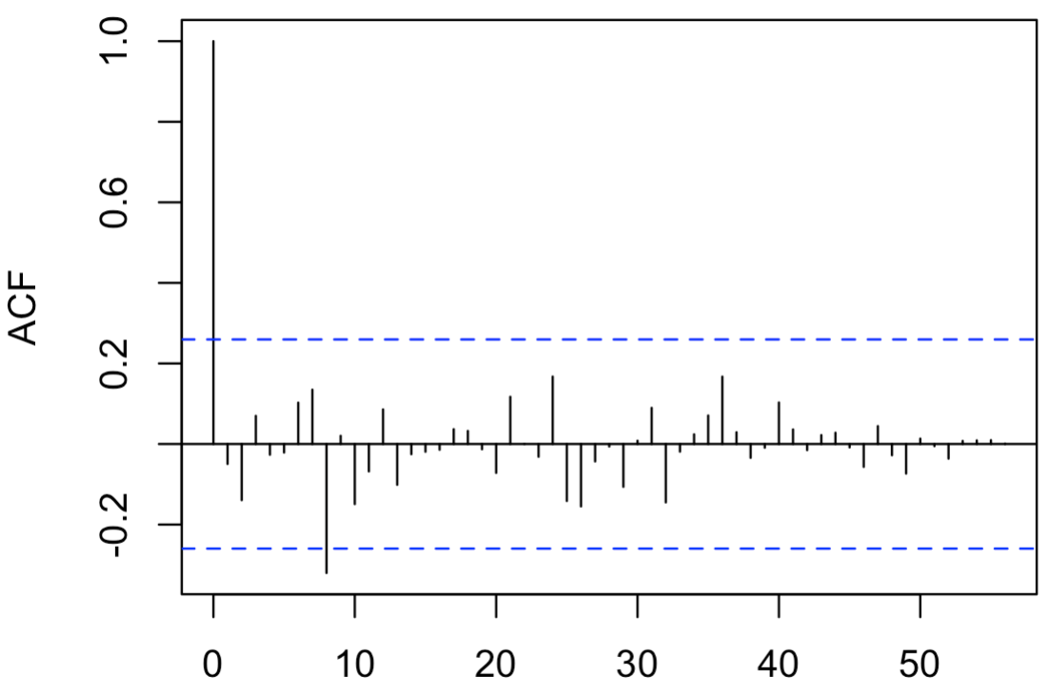
Model diagnostics: autocorrelation
intercept only
model
quadratic
model
Notes:
the correlation of the residuals (as a time series) with its own lags // the residuals should be white noise. So they should have no autocorrelation. If you have significant autocorrelation (you have to test this) and not just one spike at high lag order in your acf/pacf this maybe an indicate that you specified your model wrong.

Slide 10
Seasonality and time trends

Slide 11
Time series patterns
Seasonal: Outcomes are impacted by seasonal factors (season, month, day of the week)
Fixed with known frequency
Easily mistaken with fluctuations (must be related to some aspect of calendar time)
Trend: Long-term increase or decrease in the data.
Trends can change direction over time
Trends do not need to be linear
Source: Forecasting: Principles and Practice (https://otexts.com/fpp2/)

Slide 12
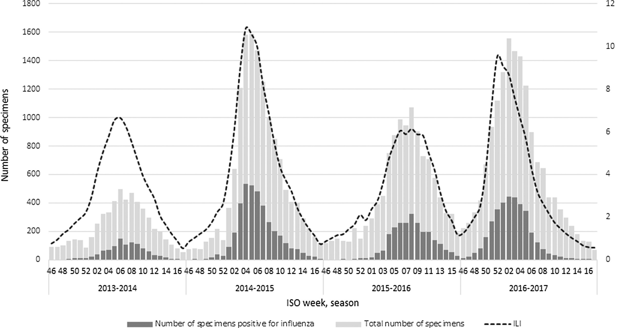
Influenza in Italy
(Rosano et al., 2019)
Notes:
End of January through March (Winter months) and decreases in the cold months.

Slide 13
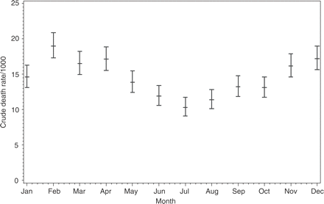
Death rates in Burkina Faso from 1993-2001
(Kynast-Wolf et al., 2005)

Slide 14
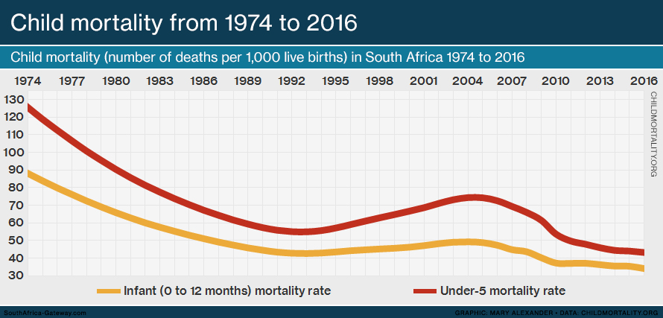
Notes:
Sometimes we will refer to a trend as “changing direction,” when it might go from an increasing trend to a decreasing trend.

Slide 15
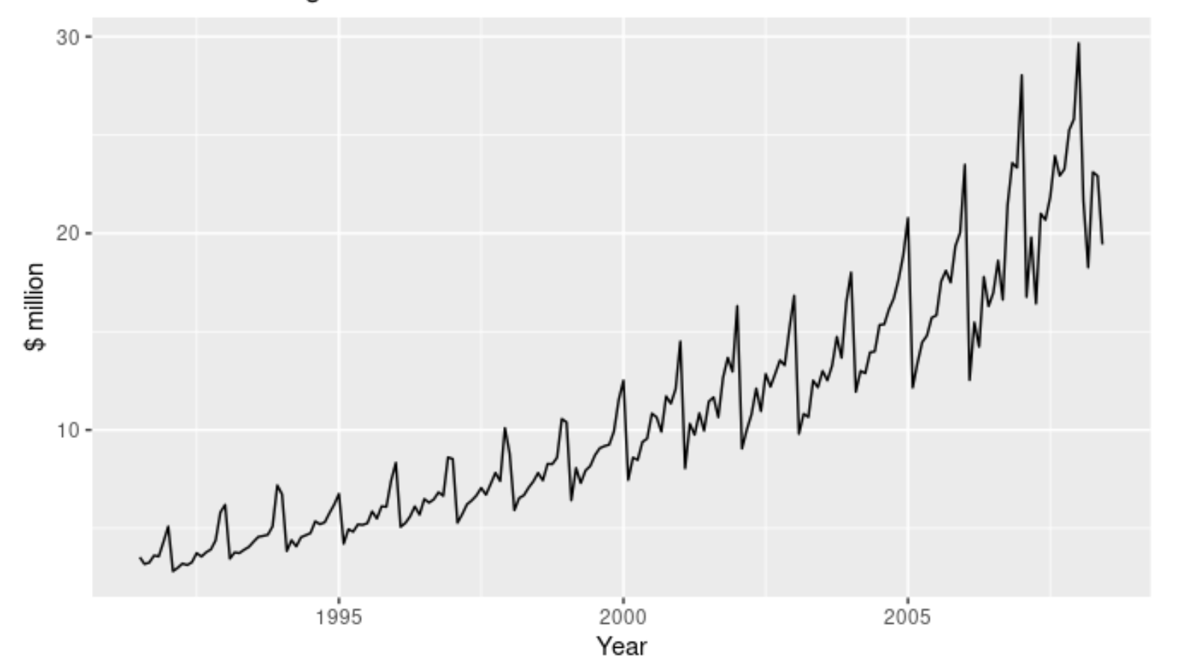
Antidiabetic drug sales in Australia
Source: Forecasting: Principles and Practice (https://otexts.com/fpp2/)
Notes:
There is also a strong seasonal pattern that increases in size as the level of the series increases. The sudden drop at the start of each year is caused by a government subsidisation scheme that makes it cost-effective for patients to stockpile drugs at the end of the calendar year.

Slide 16
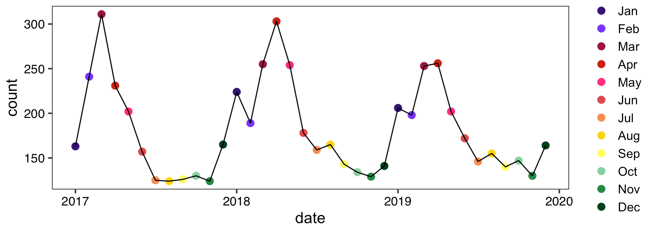
Activity: Malaria cases in Malawi facility
Please go to www.menti.com with 1576 1881

Slide 17
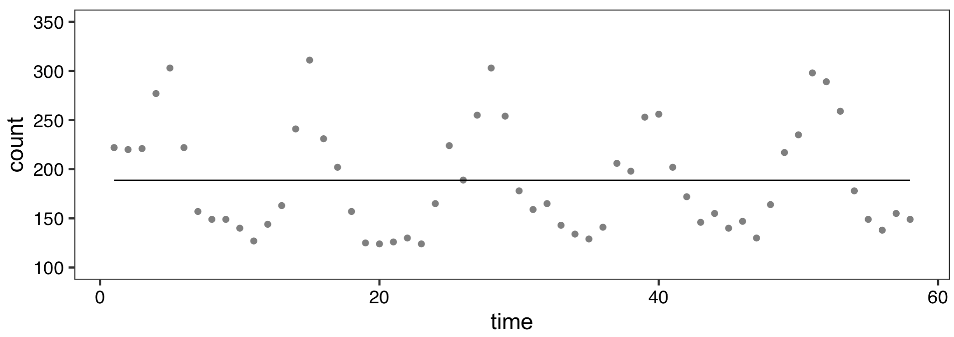
Malaria cases in Malawi facility
outcome_{t} =β₀+ε_{t}

Slide 18
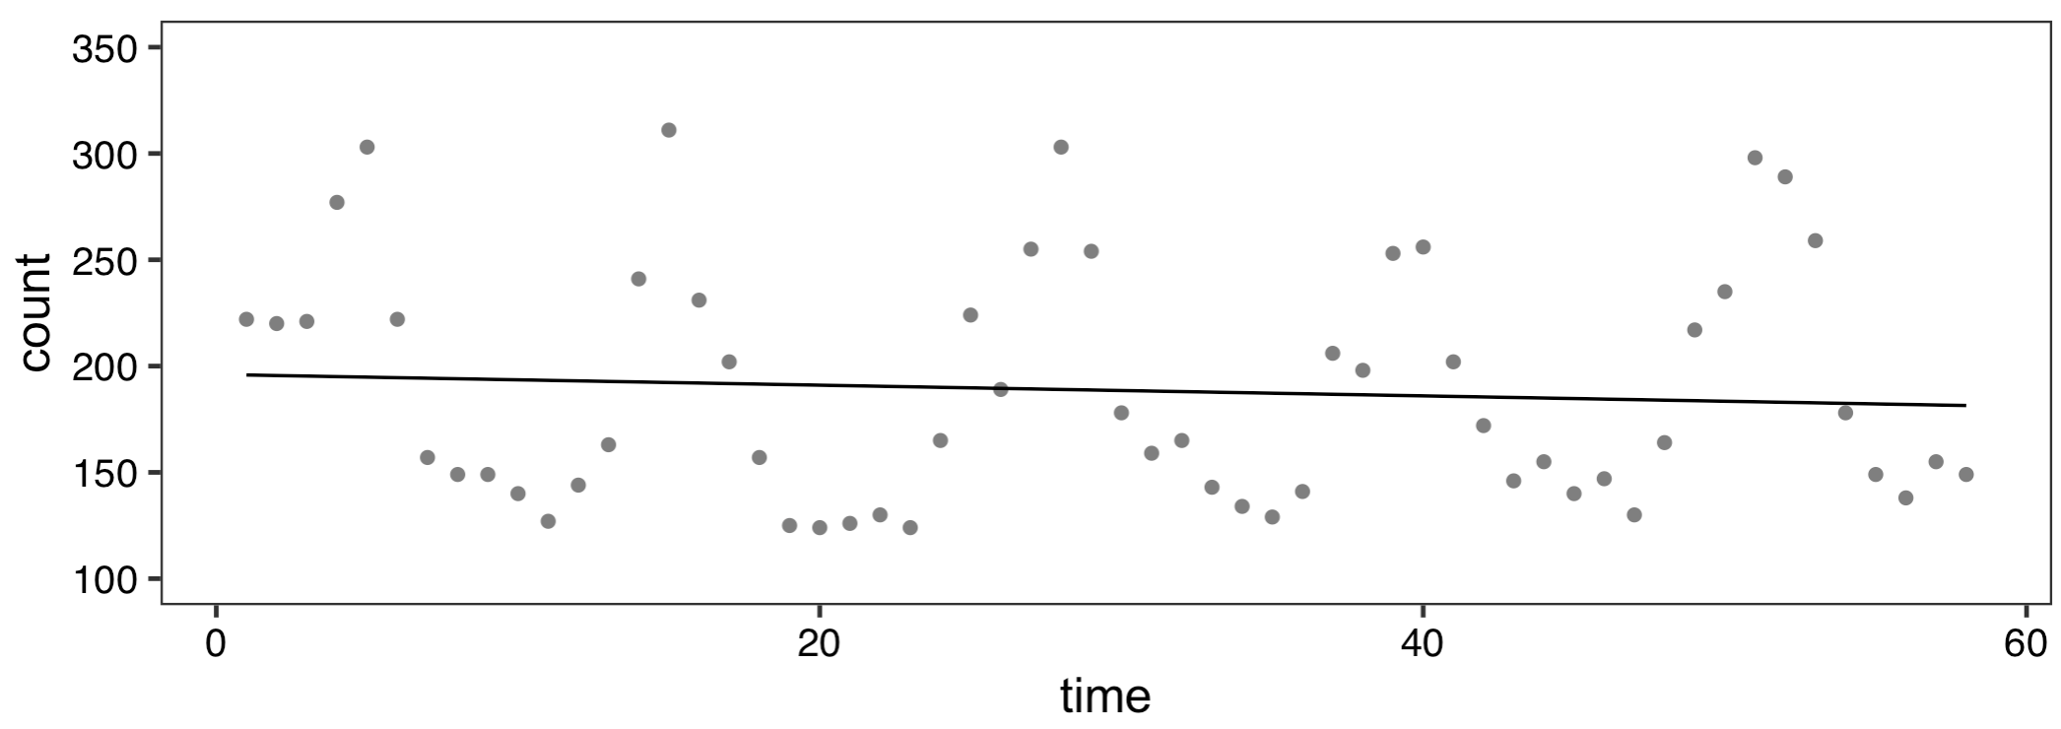
Malaria cases in Malawi facility
outcome_{t} =β₀+ β₁·time+ε_{t}

Slide 19
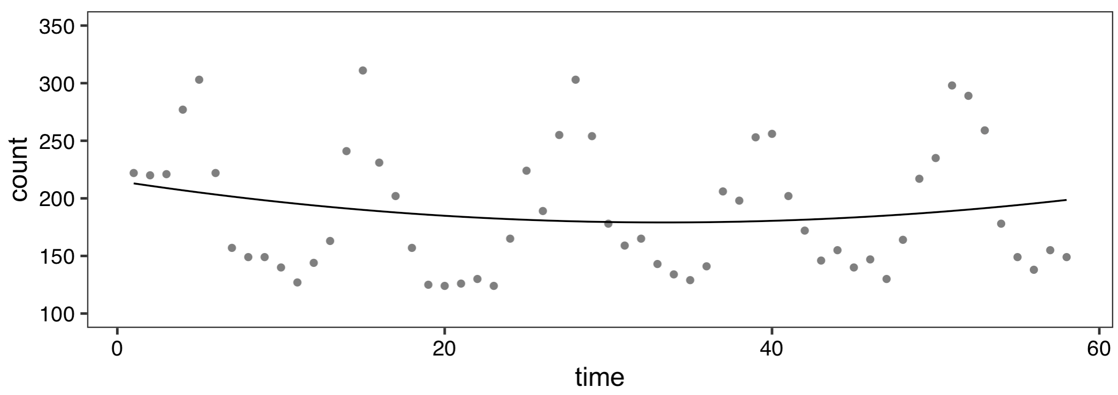
Malaria cases in Malawi facility
outcome_{t} =β₀+ β₁·time+β₂·time²+ε_{t}

Slide 20
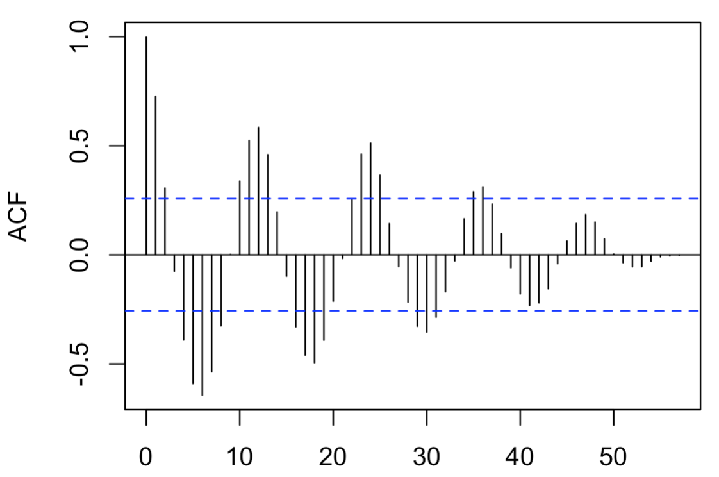
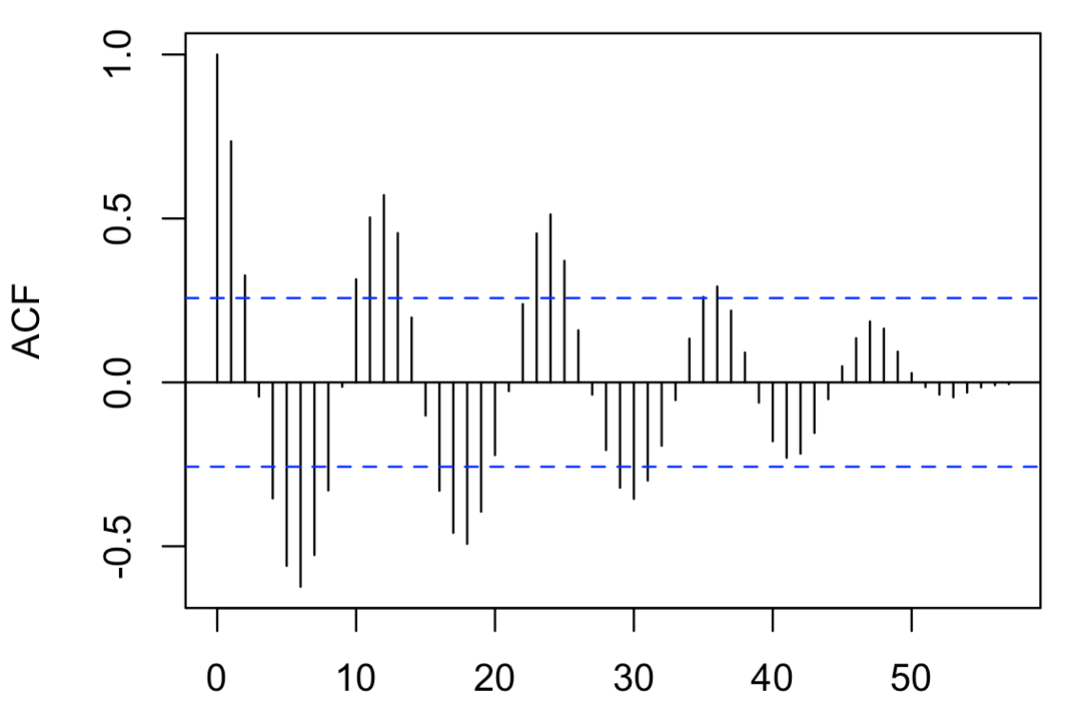
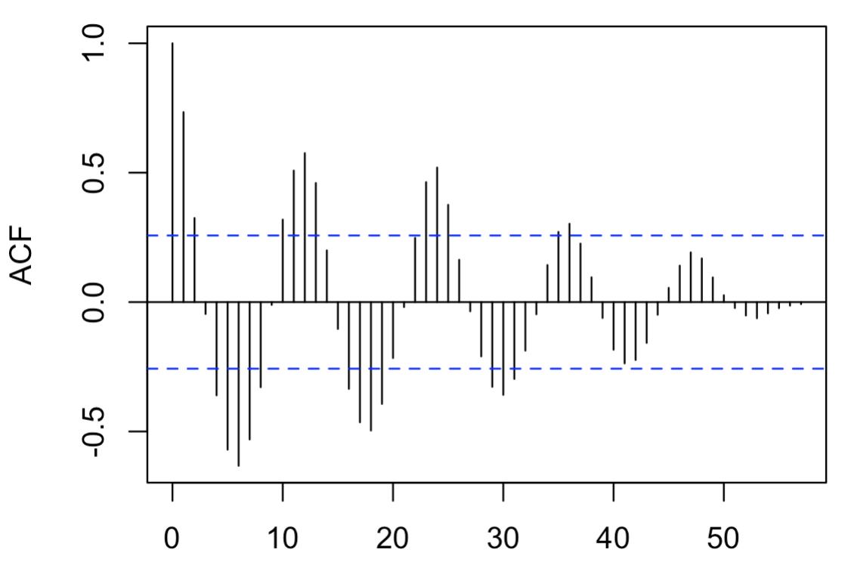
Model diagnostics: autocorrelation
intercept only
model
intercept and slope
model
quadratic
model
None of these models see any improvement over the other!
Need another method to capture “seasonality”!

Slide 21
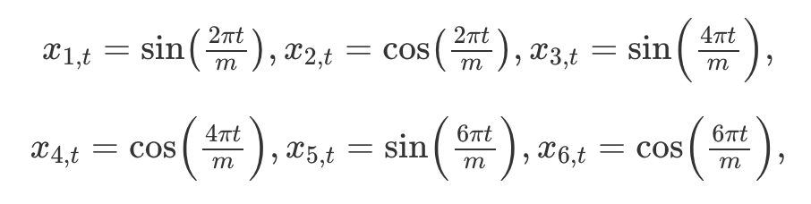
How to deal with seasonality and trend?
Seasonality: Fourier series are popular ways to deal with seasonality in time series models (other options: splines, dummy variables, etc.)
Trends: Add a linear term(s) to capture yearly trend
Will only capture linear decreases or increases over time
If changes are not linear, dummy variables or more complex transformations (log, quadratic, etc.) can be used
Source: Forecasting: Principles and Practice (https://otexts.com/fpp2/)

Slide 22
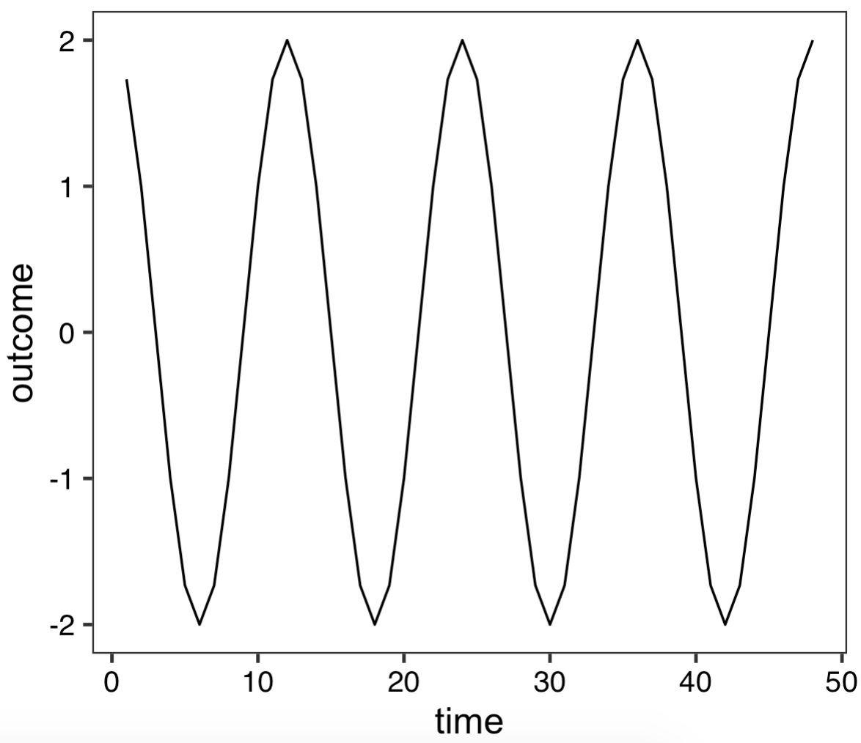
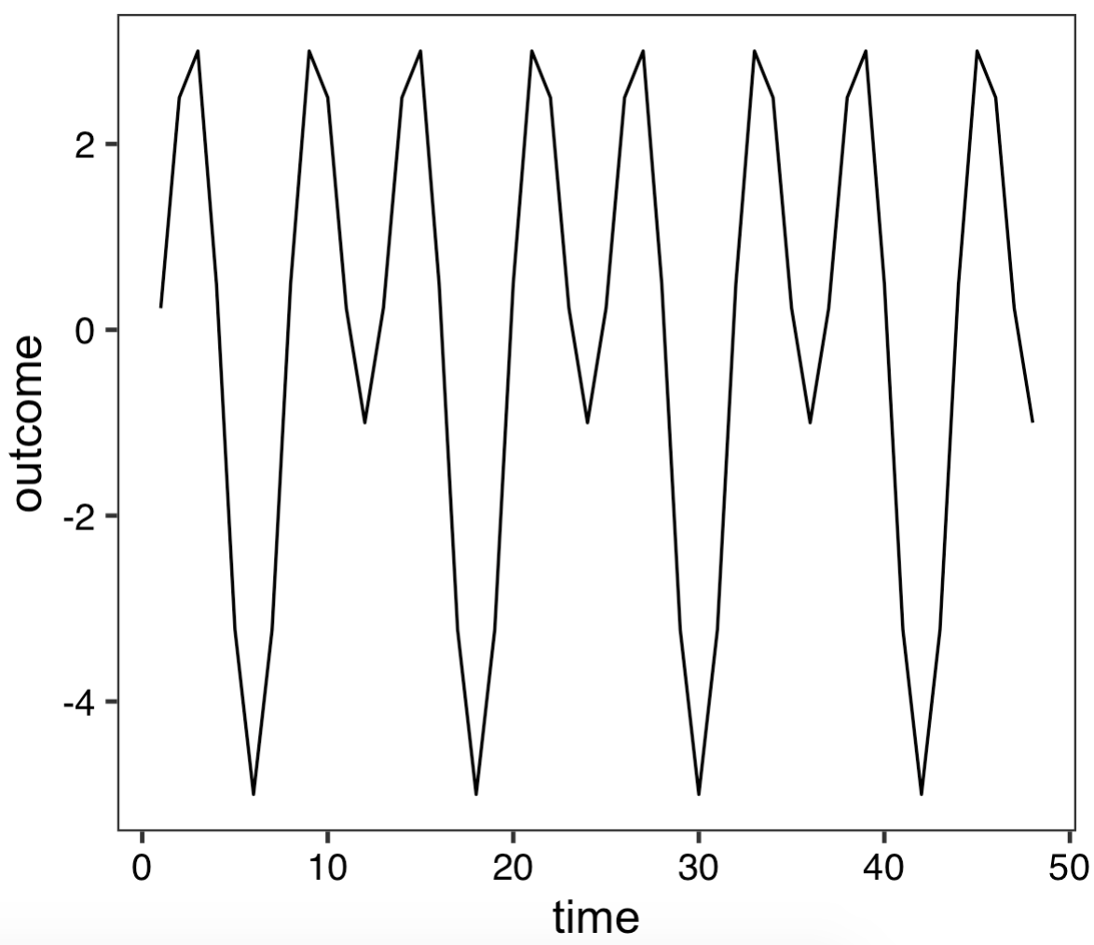
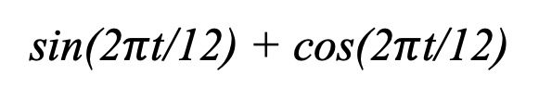
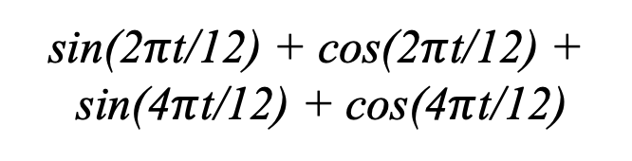
Fourier series (examples)
sin(2$π$t/12) + cos(2$π$t/12) +
sin(4$π$t/12) + cos(4$π$t/12)
sin(2$π$t/12) + cos(2$π$t/12)

Slide 23
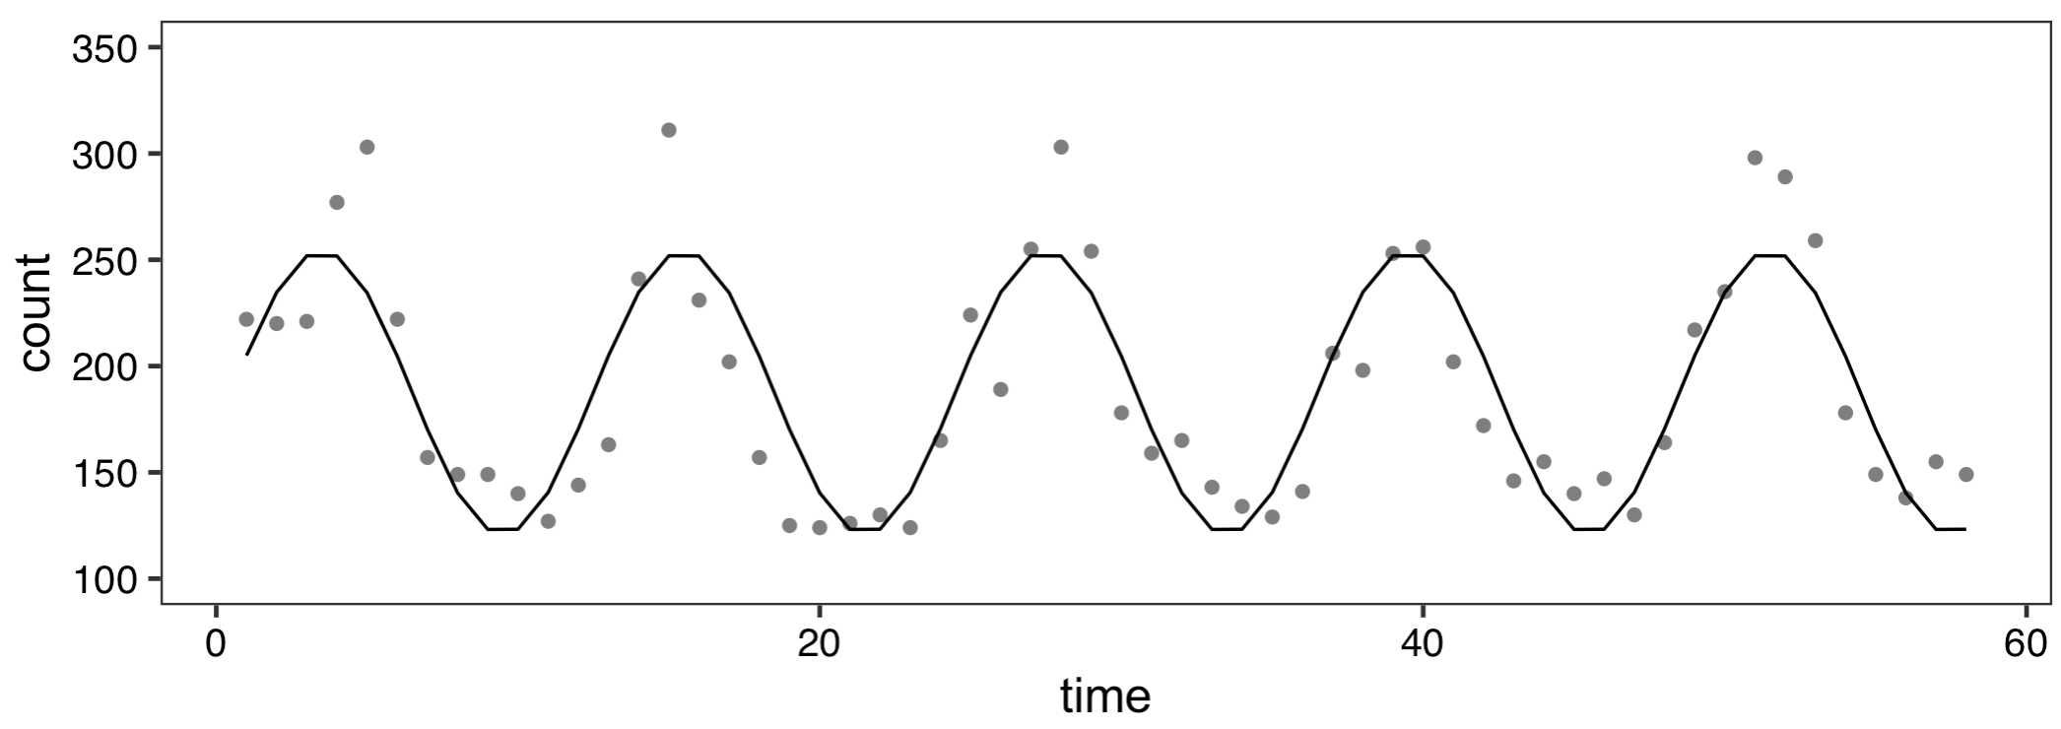
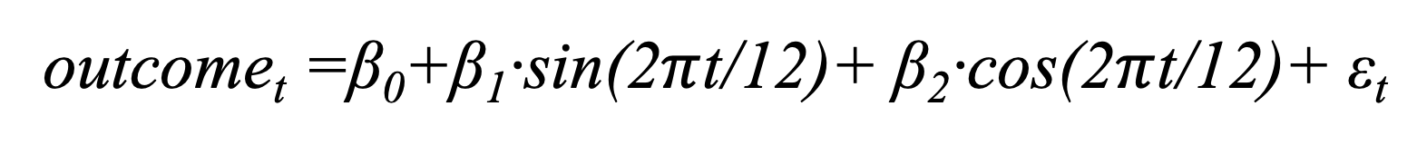
Malaria cases in Malawi facility
outcome_{t} =β₀+β₁·sin(2$π$t/12)+ β₂·cos(2$π$t/12)+ ε_{t}

Slide 24
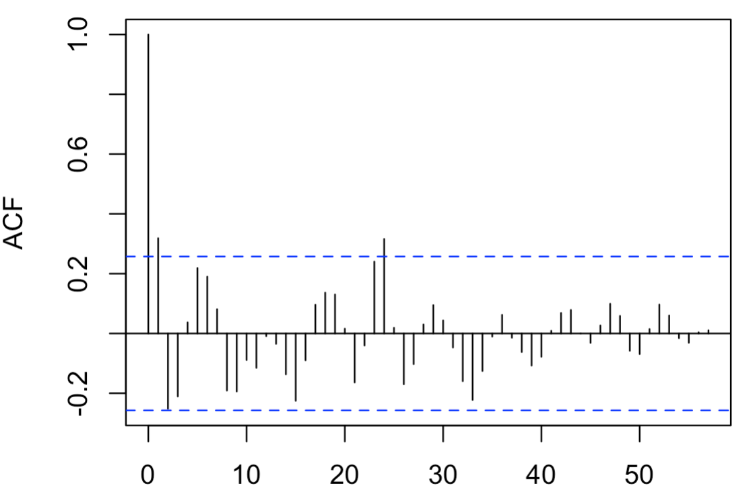
Model diagnostics: autocorrelation

Slide 25
Syndromic surveillance

Slide 26
Research questions with time series data
Describe the behavior of an indicator over time
Is infant mortality decreasing over time? By how much?
What are the seasonal differences in malaria cases?
Detect deviations from expected in an indicator
Is a region experiencing higher than expected cases of diarrhea?
Is the number of health facility deliveries lower than expected?
Measure the impact of an intervention on an indicator
After social distancing measures were put in place, how many fewer COVID-19 cases were there?
Notes:
What have we done so far?

Slide 27
Detecting deviations from expected
Syndromic surveillance: is the process of monitoring data on symptoms or outcomes related to a disease as a way to detect areas that might be affected by the disease.
Pros:
Provide “warnings” for local areas.
Uses existing data.
Process can be automated.
Cons:
Not as good as monitoring the disease directly.
Changes could be explained by other factors that should be considered.
Notes:
QUESTION: What are some “Other factors” that should be considered?

Slide 28
How to conduct syndromic surveillance
Step 1. Choose relevant indicators to follow over time (Session 1) and format data for analysis (Session 4)
Step 2. Determine baseline and evaluation periods
Step 3. Fit time series model to baseline period (Sessions 2 & 3)
Step 4. Using the model from Step 3, calculate deviations from expected in the evaluation period (Session 3)
Step 5. Produce interpretable visualizations (Session 5)

Slide 29
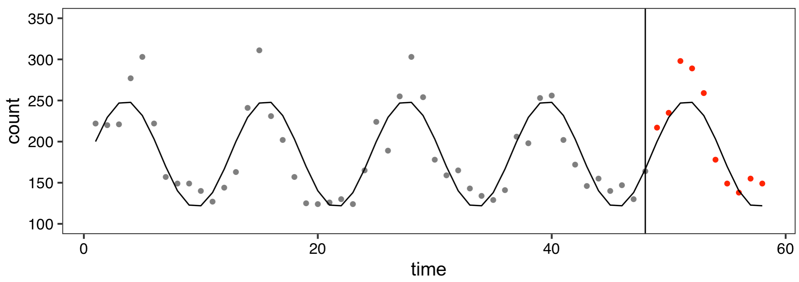
Group activity: how should we calculate deviations from expected?

Slide 30
Group activity: how should we calculate deviations from expected?
Are the number of malaria cases higher or lower than expected in January 2020? By how many malaria cases?
In the evaluation period, are the observed numbers of malaria cases systematically higher than expected, lower than expected, or is there no discernable pattern?
Does using predicted cases - observed cases to identify deviations make sense? How could this measure be improved?
Your group should answer these questions on a Google Form in a Breakout Room.
Notes:
https://docs.google.com/document/d/1n8NZmXi12ud3Tq3XwukmNPi-yvOaJGAb4Xc4hy9yAtk/edit?usp=sharing
https://docs.google.com/document/d/1i3niCRspaYgCFyZv4FedHjm_qgTudJTf4JFzv2qPIFM/edit?usp=sharing
https://docs.google.com/document/d/1SnbNNXhEPTjM_WFsJGb4PKfKYwMf44laHU5ic4cyec4/edit?usp=sharing
https://docs.google.com/document/d/1BMacpBTOfr9AEuDAePF_fRnLcrLjUgW9sbjulRaNRWo/edit?usp=sharing
https://docs.google.com/document/d/1Mt0tlsT_VXwZyOOjUNcs34OBCBfgehutNO45ZnnlMTA/edit?usp=sharing
https://docs.google.com/document/d/1g9GR6NagLkLczVDEIxIeCLw1wB_QpshNcQmFzXU_3wg/edit?usp=sharing

Slide 31
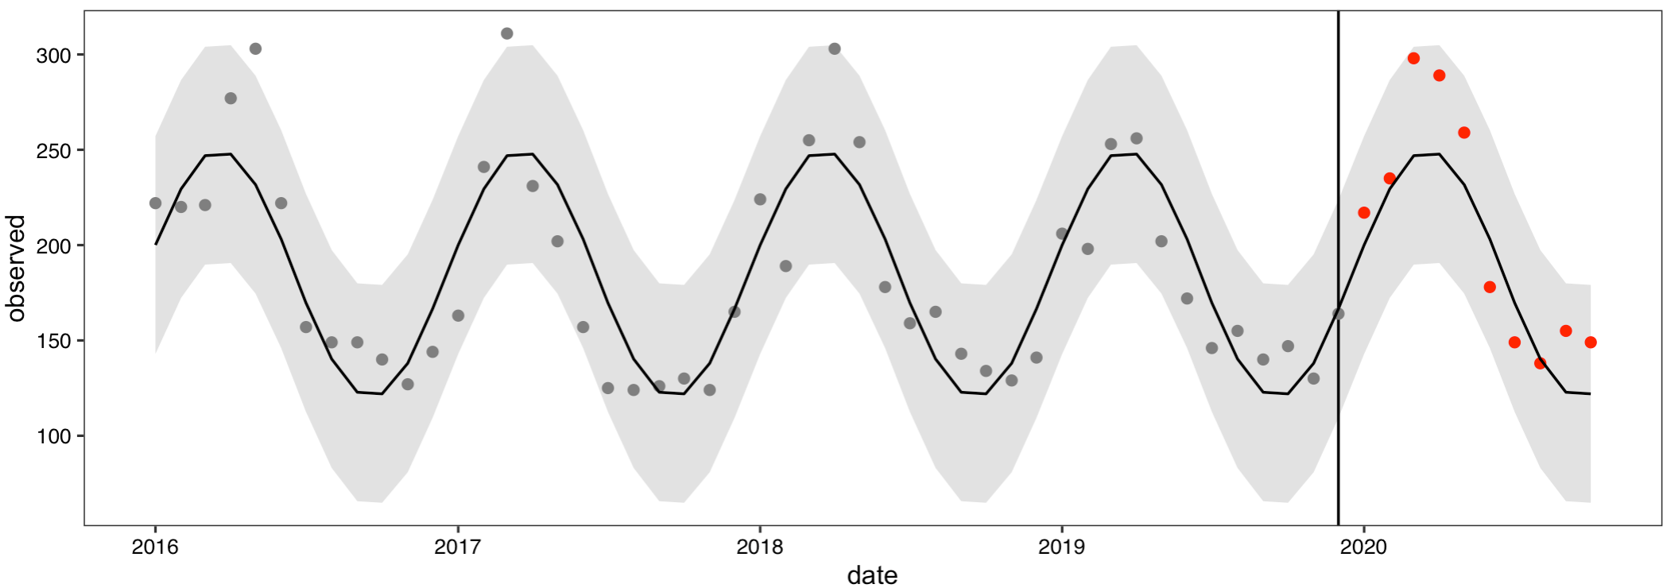
Prediction intervals
Prediction interval: the range of values where a future individual observation (monthly count) is likely to fall.
Prediction intervals are different than confidence intervals, because they correspond to an individual value, not the mean.

Slide 32
Lab activity: Syndromic Surveillance of Acute Respiratory Infection Cases at Liberia facility
Lab will be taught by Don today

Slide 33
Next lecture: Cleaning the Data
Extracting data
Setting up data in usable format
Identifying outliers
Dealing with missing data
Automation

